Slide 1
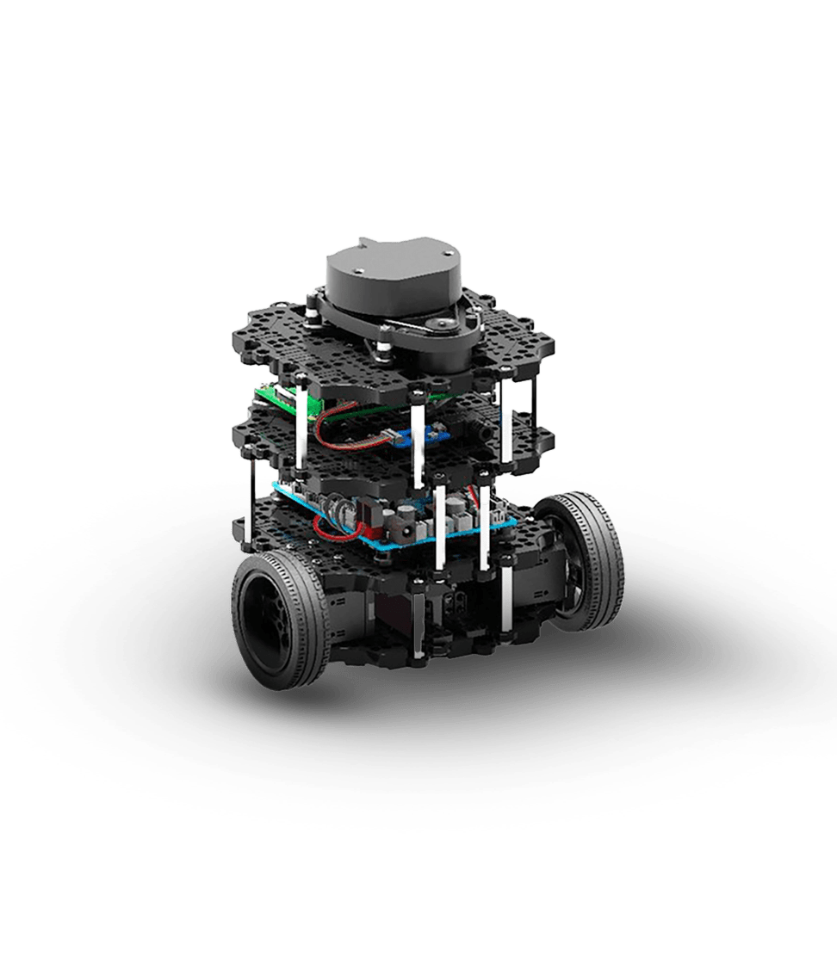
Project Idea
Alessio Petrone
Silas Leuenberger
Notes:
https://robotican.net/turtlebot-open-source-personal-research-robot-2/

Slide 2
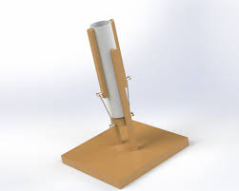
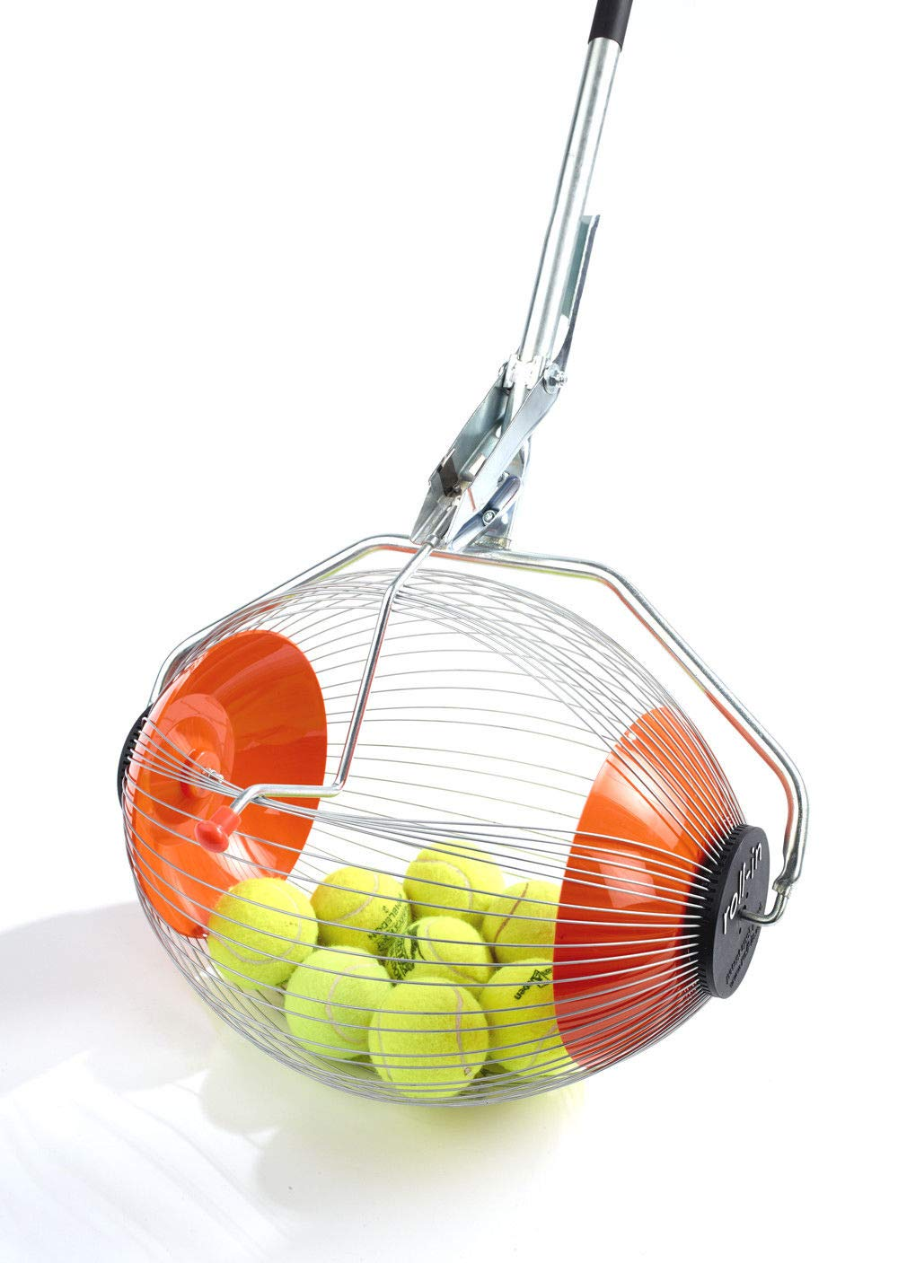


Have a Robot that ...
Propulses lights into the air
Automatically move to one of those
Collect them individually
Notes:
Propulsion: https://kolaszek.medium.com/moving-on-to-the-ping-pong-launcher-20afc0eca722
Collect: https://www.amazon.de/-/en/Kollectaball-K-MAX-Collector-coaching-accessories/dp/B07CGCHWRP
Turtlebot3: https://robotican.net/turtlebot-open-source-personal-research-robot-2/

Slide 3
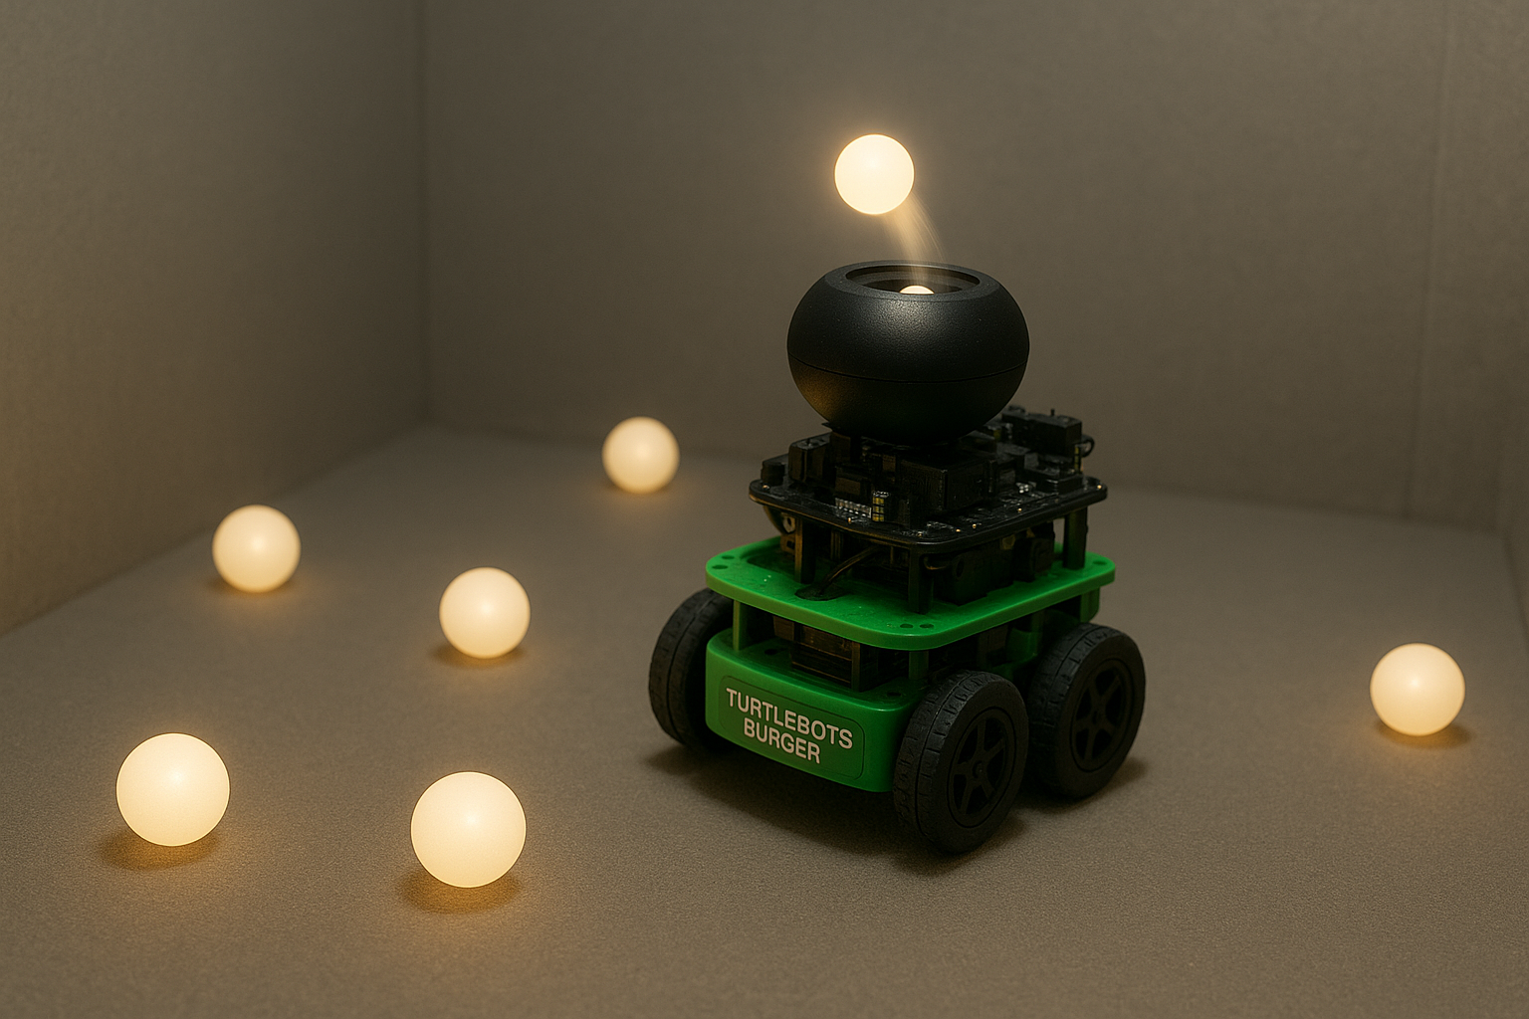
Have a Robot that ...
Propulse lights into the air
Automatically move to one of those
Collect them individually
Notes:
Robo: ChatGPT

Slide 4
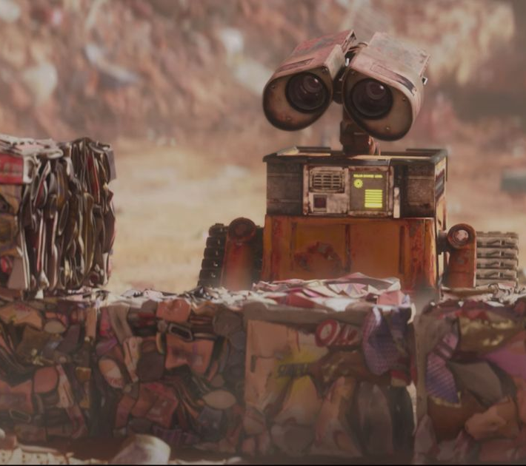
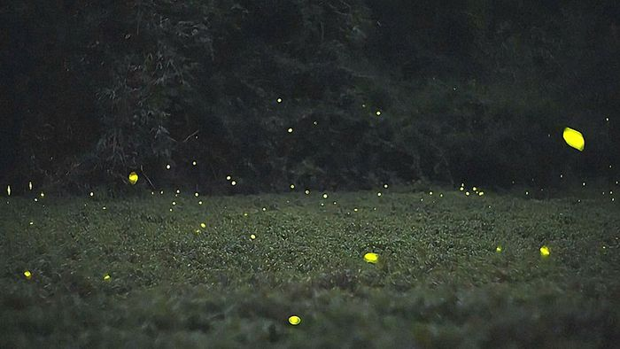
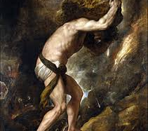
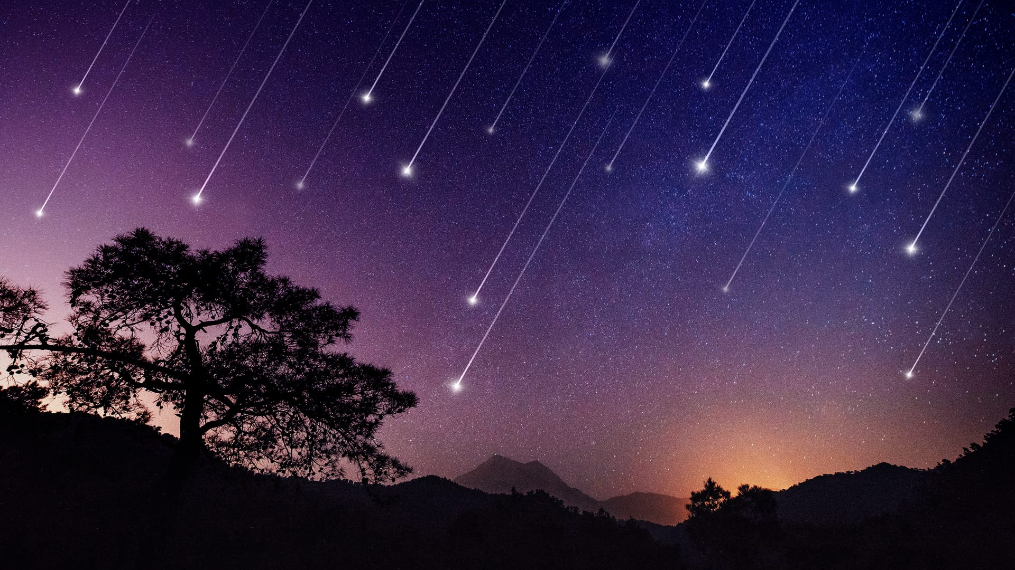
Dramaturgy and Hope
Wall-E
Fireflies
Drama: Tiny robot, tireless work in darkness.
Hope: Small sparks of light in the dark
Sisyphos
Shotting Stars
Drama: Endless cycle, persistence despite pointlessness
Hope: Brief bursts of light
Notes:
Sisyphos: https://www.google.com/imgres?q=sisyphos&imgurl=https%3A%2F%2Fupload.wikimedia.org%2Fwikipedia%2Fcommons%2Fthumb%2F4%2F43%2FPunishment_sisyph.jpg%2F250px-Punishment_sisyph.jpg&imgrefurl=https%3A%2F%2Fde.wikipedia.org%2Fwiki%2FSisyphos&docid=hHw5TL1HD-wOmM&tbnid=nUKwRLZqijYQWM&vet=12ahUKEwjbrfqWw4KQAxVf0AIHHeYtE-8QM3oECB0QAA..i&w=250&h=284&hcb=2&ved=2ahUKEwjbrfqWw4KQAxVf0AIHHeYtE-8QM3oECB0QAA
Wall-E: https://www.google.com/imgres?q=wall-e%20collecting%20trash&imgurl=https%3A%2F%2Fsearial-cleaners.com%2Fwp-content%2Fuploads%2F2023%2F01%2FPourquoi-WALL-E-est-peut-etre-le-film-Pixar-le-plus-politiquement.jpg&imgrefurl=https%3A%2F%2Fsearial-cleaners.com%2Fwall-e-syndrome%2F&docid=4BwiMNt0u4Kj2M&tbnid=1czcUKvmfrLdyM&vet=12ahUKEwi3rMXSzYKQAxVL2wIHHfi-OPAQM3oECB8QAA..i&w=1200&h=630&hcb=2&ved=2ahUKEwi3rMXSzYKQAxVL2wIHHfi-OPAQM3oECB8QAA
Shooting Stars: https://starwalk.space/de/news/tips-for-watching-meteor-showers
Fireflies: https://at.wetter.com/videos/nachrichten/leuchten-in-der-nacht-gluehwuermchen-sorgen-fuer-spektakel/6807920ce31ed40f140d5f63

Slide 5
















Plan
"..
Create LED-balls (LED inside Ping Pong Ball)
Create throwing mechanism
Add collecting machine
Move autonomously towards LED-Balls

Slide 6
Any questions?

